Slide 1
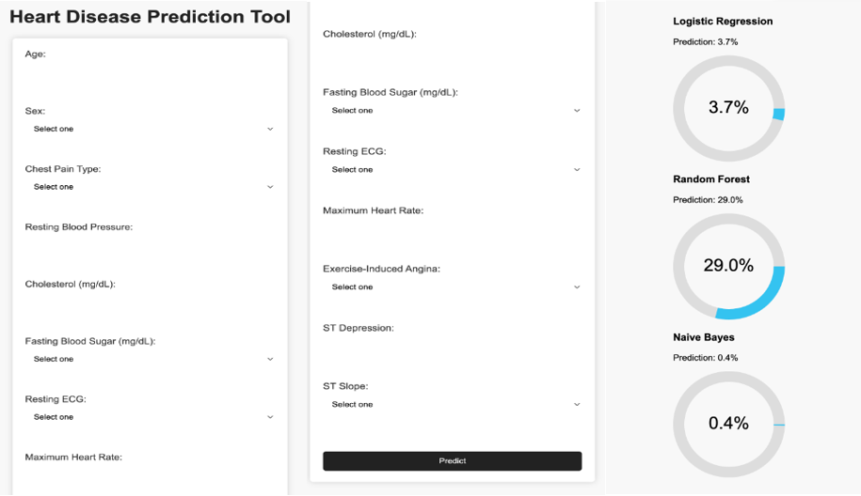
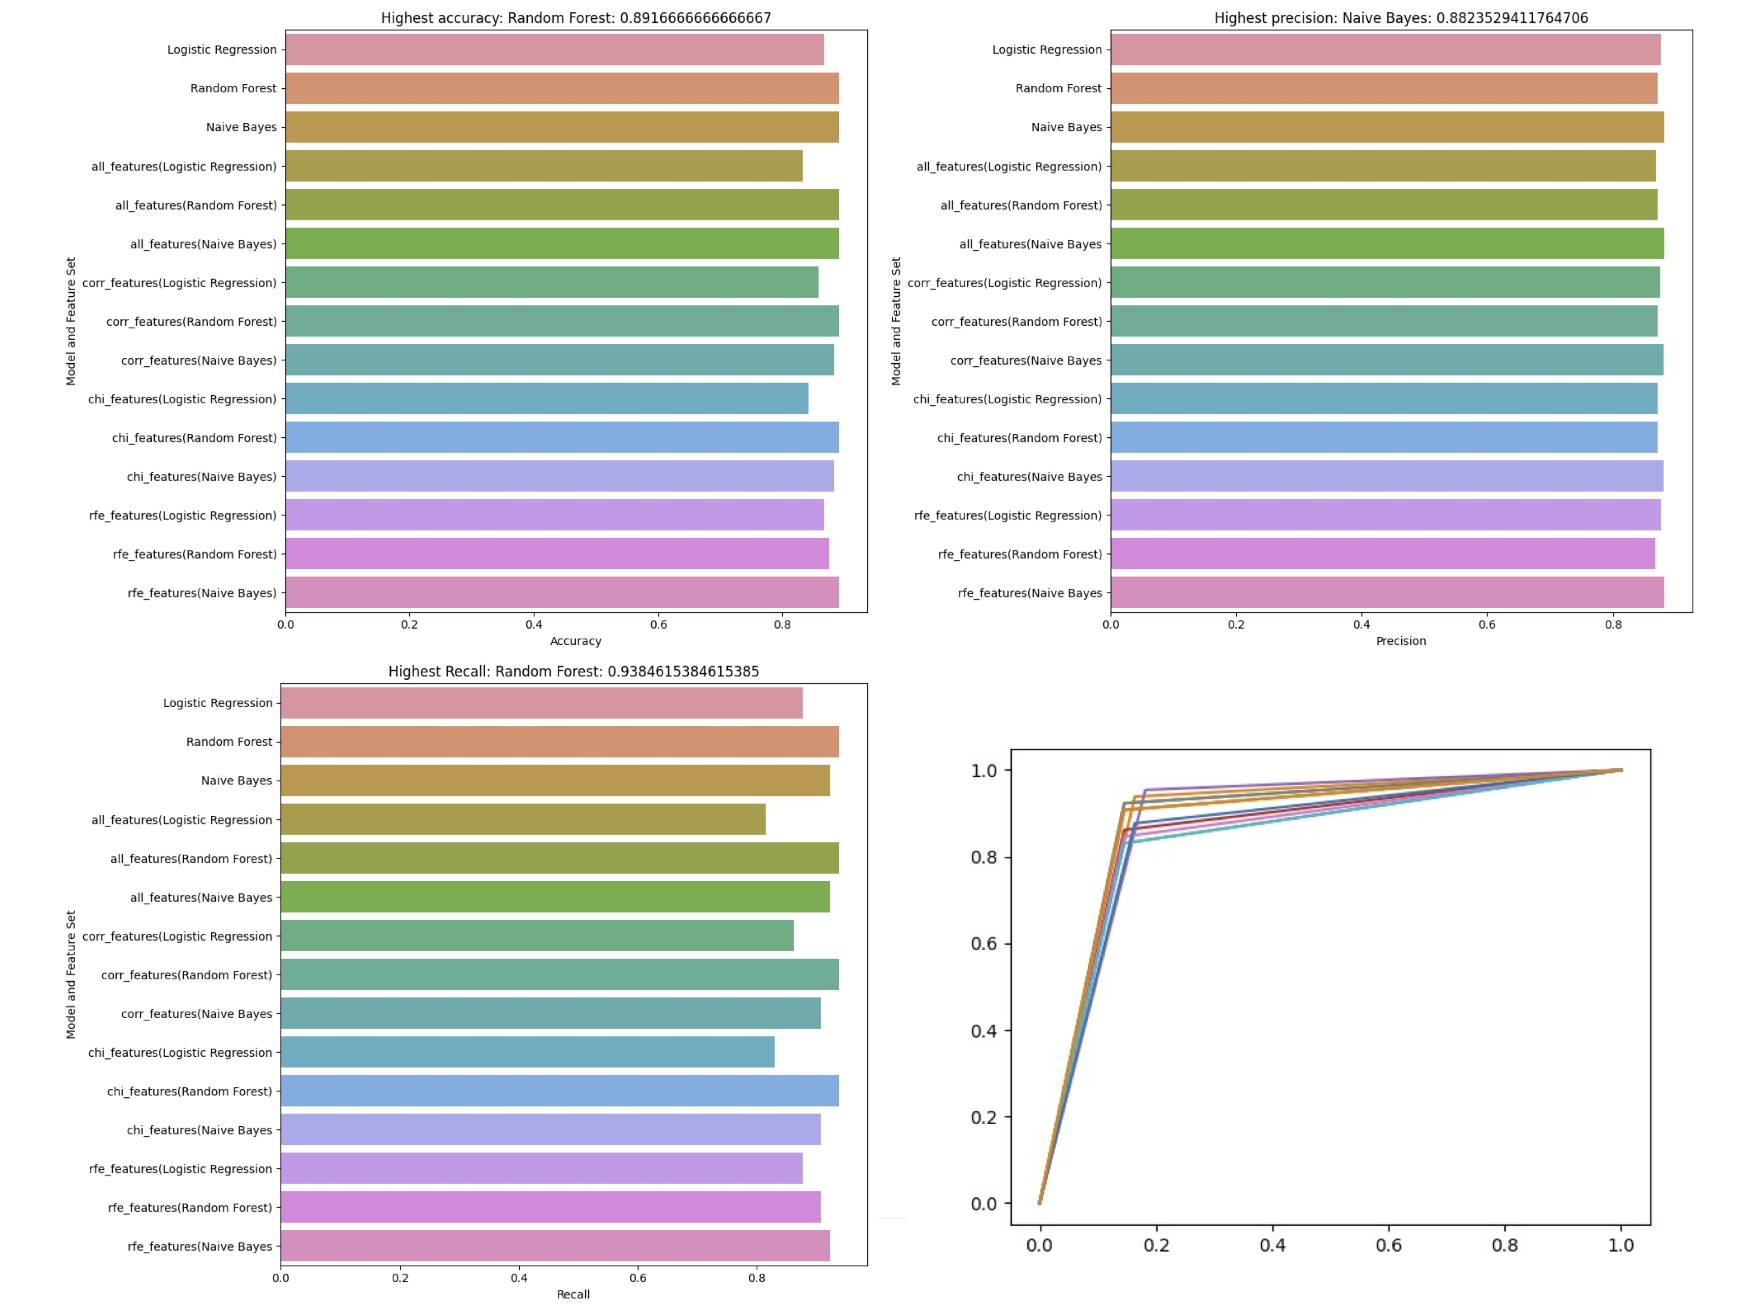
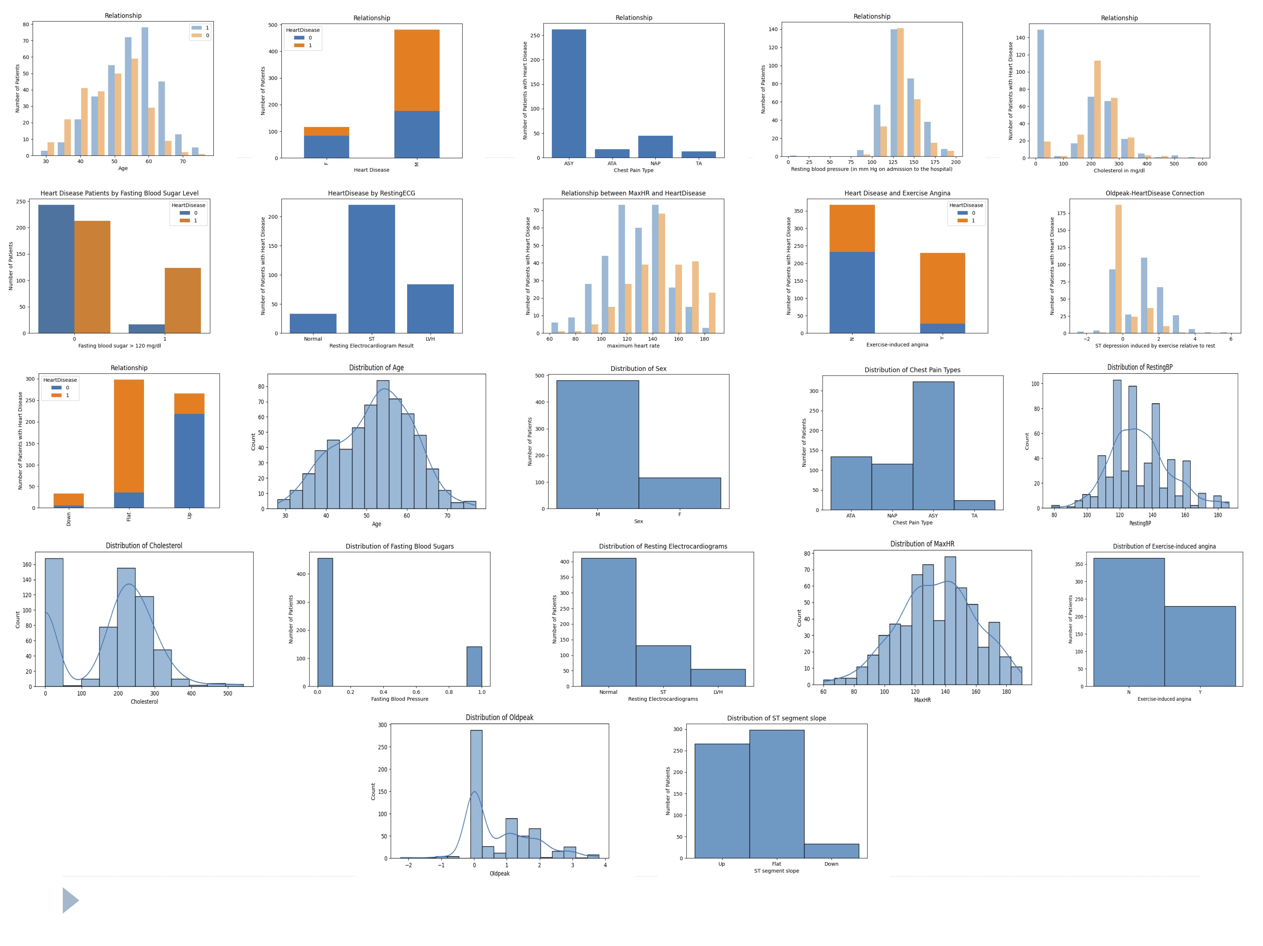

AI Medical Diagnosis Prediction Tool for Heart Disease
Introduction:
Evaluation:
Heart disease is the leading cause of death globally, accounting for millions of fatalities each year. It encompasses a range of conditions affecting the heart and blood vessels, such as coronary artery disease, heart failure, and arrhythmias. Traditional diagnostic methods, such as physical exams, blood tests, and imaging tests, can be time-consuming, expensive, or invasive. This project aims to develop an AI-powered medical diagnosis prediction tool that utilizes machine learning algorithms to predict the presence of heart disease based on patient data. The tool has the potential to save lives, reduce healthcare costs, and improve the overall quality of care for individuals affected by heart disease.
The prediction tool was evaluated using a test dataset that was distinct from the data used to train the model. The primary purpose was to evaluate the model's performance and capacity to generalize to previously encountered data. The model was evaluated using criteria such as accuracy, precision, recall, and the ROC curve. Overall, the model predicted heart disease effectively, with high scores for accuracy, precision, and recall. The ROC curve revealed a significant trade-off between sensitivity and specificity, suggesting the model's resilience in dealing with various decision thresholds. Future study might concentrate on refining the model by experimenting with various algorithms, feature selection strategies, and parameter tweaking methods to improve its prediction powers.
Implementation:
Handling missing values, converting categorical features to numerical representations, normalizing/standardizing numerical features, feature selection, model selection and training, model evaluation, user interface development, input validation and error handling, prediction and result display, and statistical analysis are all part of data preprocessing and cleaning. Model selection and training entails selecting the best machine learning algorithm and training it on a dataset. Model performance is assessed using criteria like as accuracy, precision, recall, ROC curve, user interface creation, input validation and error handling, prediction and result presentation, and statistical analysis.
Conclusion
Using patient data, this research entailed constructing an AI medical diagnostic prediction tool for heart disease. Data preprocessing and cleaning, feature selection, model selection and training, model assessment, user interface creation, and displaying predictions and outcomes were all part of the process. The relevance of the initiative stems from its potential to enhance early identification and treatment of heart disease, hence lowering its impact on public health. Several lessons were learned throughout the development process, including the importance of data quality, the importance of feature selection, and the necessity of model fine-tuning for optimal performance. Future enhancements to the AI tool could include the incorporation of additional patient data sources, the exploration of more advanced machine learning techniques, and the refinement of the user interface for a better user experience. The tool's accuracy and usefulness will depend on continuous examination and upgrading as new data and studies emerge.
UNIVERSITY OF THE PACIFIC
Mansoor H., Korie. W, Kelvin L.

